Slide 1


Healthy Lifestyle
Nour Hanna
Patient Engagement Specialist
Family Health Centers of San Diego
Patient Care Support Services Department
12/31/2014

Slide 2



Make Healthy Lifestyle Changes!
Smoking:
Stop smoking: if you smoke its time to stop now!
Smoking can cause:
Heart attack and stroke
Cigarette smokers are two to four times more likely to develop heart disease than nonsmokers.
Smoking doubles your chances of having a stroke.
One year after a person stops smoking, the risk of having a heart attack or stroke will drop by more than half
Cancer
Smoking increases your risk of developing cancers of the bladder, kidney, larynx (voice box), lung, pancreas, stomach, and uterus.
Smoking causes about 80 to 90 percent of lung cancer.
The cancer death rate for men who smoke cigarettes is more than double that of nonsmokers.
Men who smoke are 22 times more likely to develop lung cancer than men who have never smoked.
Women who smoke are 12 times more likely to develop lung cancer than women who have never smoked.

Slide 3
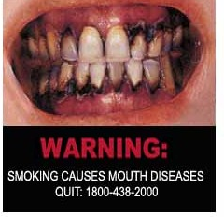
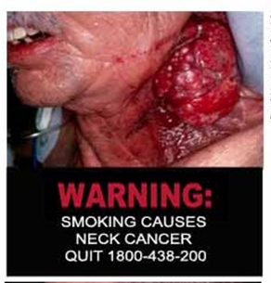
Smoking
Secondhand smoke can cause:
  Pulmonary disease
  Serious respiratory diseases
  Asthma attacks
  Affects other people, children and pets.
Unpleasant effects include:
  Yellow stains on teeth and fingers
  Bad breath
  Gum disease
  Early wrinkling of the skin
  Decreased sense of smell and taste.
Notes:
Serious respiratory diseases such as: emphysema and chronic bronchitis
More colds, sore throats, and respiratory infections

Slide 4
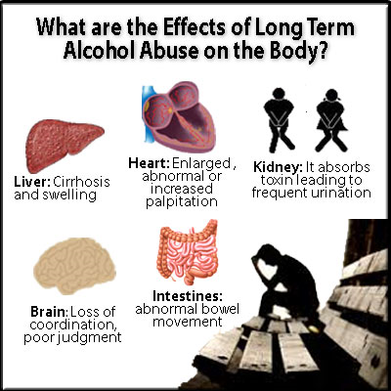
Notes:
Brain:
Alcohol interferes with the brain’s communication pathways, and can affect the way the brain looks and works.
Heart:
Cardiomyopathy – Stretching and drooping of heart muscle
Arrhythmias – Irregular heart beat
Stroke
High blood pressure
Liver:
Steatosis, fatty liver, Alcoholic hepatitis, Fibrosis, Cirrhosis.
Pancreas:
Alcohol causes the pancreas to produce toxic substances that can eventually lead to pancreatitis, a dangerous inflammation and swelling of the blood vessels in the pancreas that prevents proper digestion.
Cancer:
Drinking too much alcohol can increase your risk of developing certain cancers, including cancers of the:
Mouth, Esophagus, Throat, Liver, Breast.

Slide 5
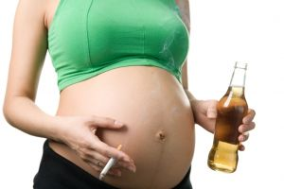
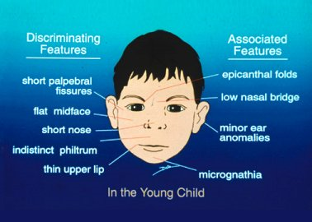
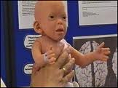
Fetal Alcohol Syndrome
Notes:
You are not just harming yourself, but your harming your child.
FAS
Fetal Alcohol Syndrome

Slide 6

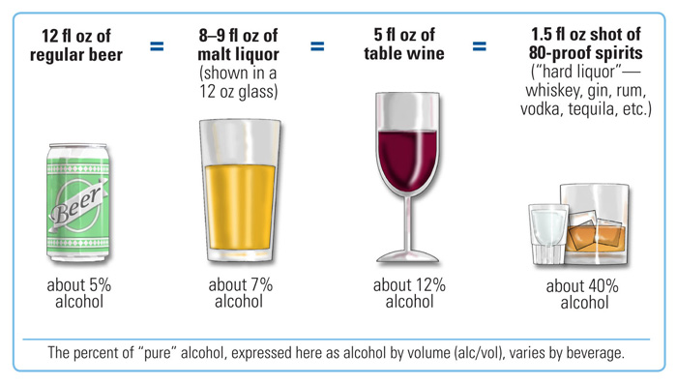
Alcohol Consumption
Moderate Alcohol Consumption:
According to the Dietary Guidelines for Americans, moderate drinking is up to 1 drink per day for women and up to 2 drinks per day for men.
Binge Drinking:
NIAAA defines binge drinking as a pattern of drinking that brings blood alcohol concentration (BAC) levels to 0.08 g/dL. This typically occurs after 4 drinks for women and 5 drinks for men—in about 2 hours.
.

Slide 7

Your child can imitate your action as a result of your behavior.

Slide 8
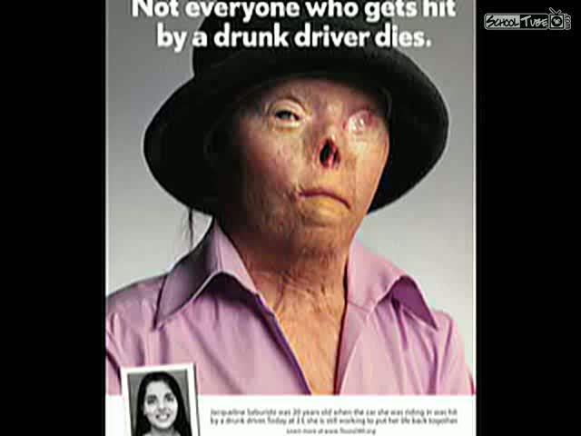
Who else is affected by your consumption?

Slide 9

What is a "Healthy Diet"?
The Dietary Guidelines for Americans describe a healthy diet as one that:
• Emphasizes fruits, vegetables, whole grains, and low-fat milk products.
• Includes lean meats, poultry, fish, beans, eggs, and nuts.
• Is low in saturated fats, trans fats, cholesterol, salt (sodium), and added sugars.

Slide 10
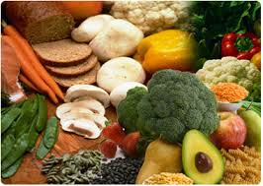
Eat more Fiber
Eat fresh fruits and vegetables.
Include oats, rice , whole grains , in your food.
Beans and potatoes are excellent sources of fiber.
When you eat more fiber, be sure to drink more water to prevent constipation.
Follow the Myplate guidelines.

Slide 11

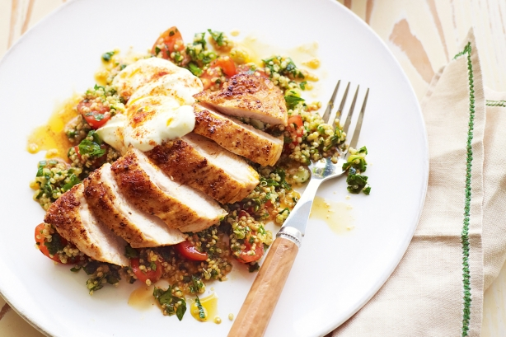
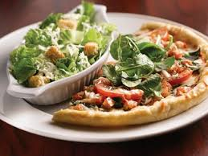
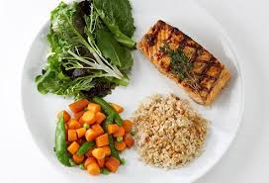
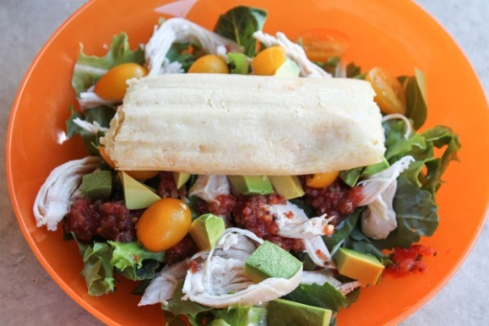
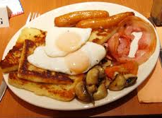
Do you think this is a balanced meal?

Slide 12

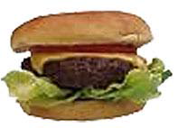
Portion Distortion
Hamburger
20 years ago
Today
333 calories
How many calories are in today’s hamburger?

Slide 13
Portion Distortion
Hamburger
20 years ago
Today
333 calories
590 calories
Calorie difference:
257 calories

Slide 14

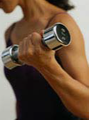
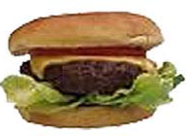
Portion Distortion
To maintain a healthy weight:
Calories in = Calories out
If you lift weights for 1 hour and 30 minutes you will burn 257 calories.

Slide 15

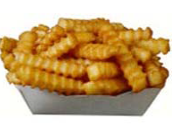
Portion Distortion
French Fries
20 Years ago
Today
210 calories
590 سعرة حرارية
How many calories are in today’s French fries?

Slide 16
Portion Distortion
French Fries
20 Years ago
Today
210 calories
610 calories
Calorie difference: 400 calories

Slide 17
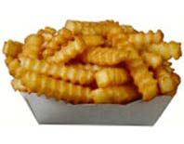
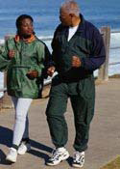
Portion Distortion
To maintain a healthy weight:
Calories In = calories out
If you walk for 1 hour and 10 minutes you will burn around 400 calories.

Slide 18
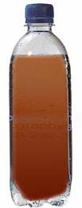
Portion Distortion
To Maintain a healthy weight:
Calories in = calories out
Soda
85 Calories
6.5 ounces
How many calories are in today’s portion?

Slide 19
Portion Distortion
To maintain a healthy weight:
Calories in = Calories out
Soda
85 Calories
6.5 ounces
Calorie difference: 165 calories
250 Calories
20 ounces

Slide 20

Portion Distortion
To maintain a healthy weight:
Calories in = Calories out
If you work in the garden for 35 minutes,
you will burn approximately 165 calories

Slide 21
Portion Distortion
A supersized meal today
Hamburger, French-fries and Soda
590 calories
610 calories
250 Calories
20 ounces
257
400
165
822
Notes:
Soda slide

Slide 22

Portion Distortion
To maintain a healthy weight:
Calories in = Calories out
3,500 calories = 1 pound
This meal has 822 extra calories.
To burn off the extra 822 calories you will need to walk for
4 hours and 50 minutes.

Slide 23
Risk Factors
An unhealthy diet is one of the major risk factors for a range of chronic diseases, including heart diseases, cancer, diabetes and other conditions linked to obesity.
Notes:
An unhealthy diet is one of the major risk factors for a range of chronic diseases, including cardiovascular diseases, cancer, diabetes and other conditions linked to obesity

Slide 24
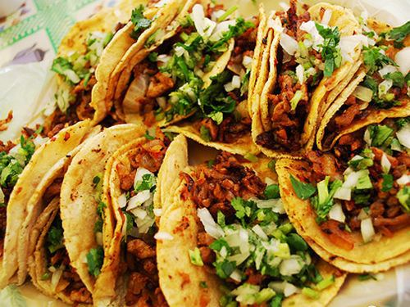
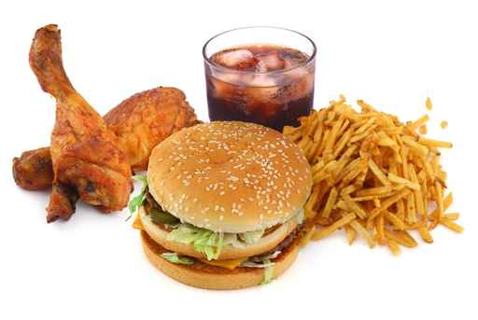
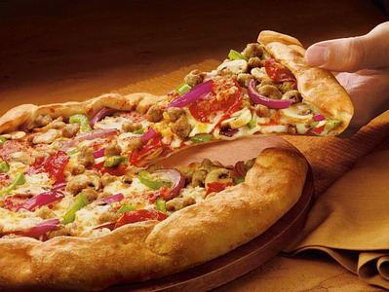

Healthy Eating Habits!
Eat less fatty foods such as:
Red fatty meat with lard
Fried dishes
Dairy products that contain high levels of fat such as:
White goat cheese
Ice cream
Whole milk
Butter
Notes:
Make Healthier choices substitute whole milk with low fat.
Oven bake instead of fried etc.

Slide 25
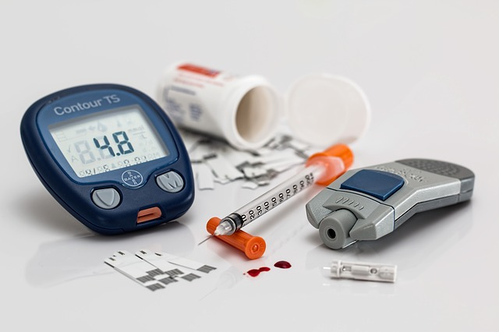
Bad eating habits may cause you to develop
Type 2 Diabetes!

Slide 26
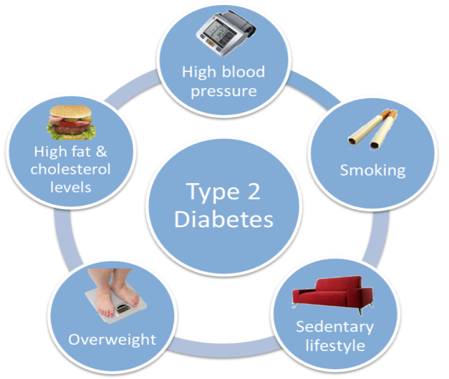
Type 2 diabetes is!
Type 2 diabetes mellitus is the most common form of diabetes.
Diabetes is a problem with your body that causes glucose (sugar ) in the blood levels to rise higher than usual, this is also called high blood sugar .
If you have diabetes type 2 your body does not use insulin sufficiently and its known as insulin resistant.
The pancreas creates enough insulin for the body, but once it becomes resistant your body does not make enough insulin in order to function normally.
In order to control your blood sugar it is important to maintain a healthy lifestyle.

Slide 27
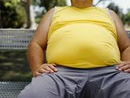


What can I do to prevent the development of chronic diseases?
Notes:
Many people question:

Slide 28
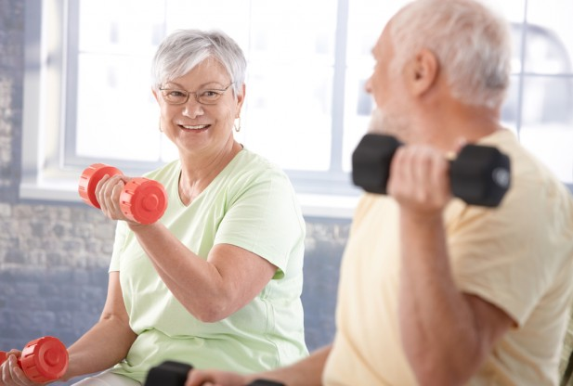


Physical Activity
Regular physical activity helps improve your overall health and fitness, and reduce the risk of many chronic diseases .
Based on the CDC recommended guidelines an adult should exercise for 30 minutes a day for 5 days a week.
This is equivalent to 2 hours and 30 minutes of physical activity a week.
You don't need a gym to exercise, you can walk at a park, and do some home exercises !

Slide 29
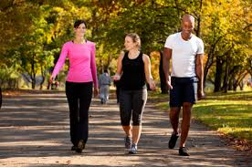

Why should you exercise?
Being physically fit improves your overall health.
Fitness reduces the development health problems.
Exercise reduces your risk of developing many health problems such as:
Heart disease
High blood pressure
Diabetes
Some types of cancer
Weight management
Sleep better
Reduce tension.

Slide 30

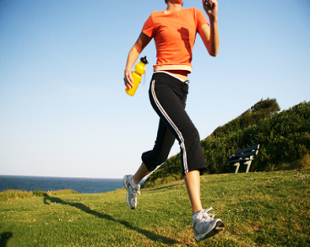
Where to get help?
Are you experiencing any sign or symptoms of any chronic diseases?
Do you have diabetes or suffering from obesity?
Family Health Centers of San Diego offers:
  Health Education counseling
  Nutrition counseling
  Weight management
  Smoking cessation classes and much more
  We are here to help you!
For more information on Health Education Services
Call: (619) 515-2526.

Slide 31

Notes:
Sources

